Slide 1

HAF Alliance – HAF for all
Douglas Hubbert – douglas.hubbert@cheshireeast.gov.uk
02 May 2023

Slide 2
Purpose of HAF?
Integration
Social mobility
Inclusion

Slide 3
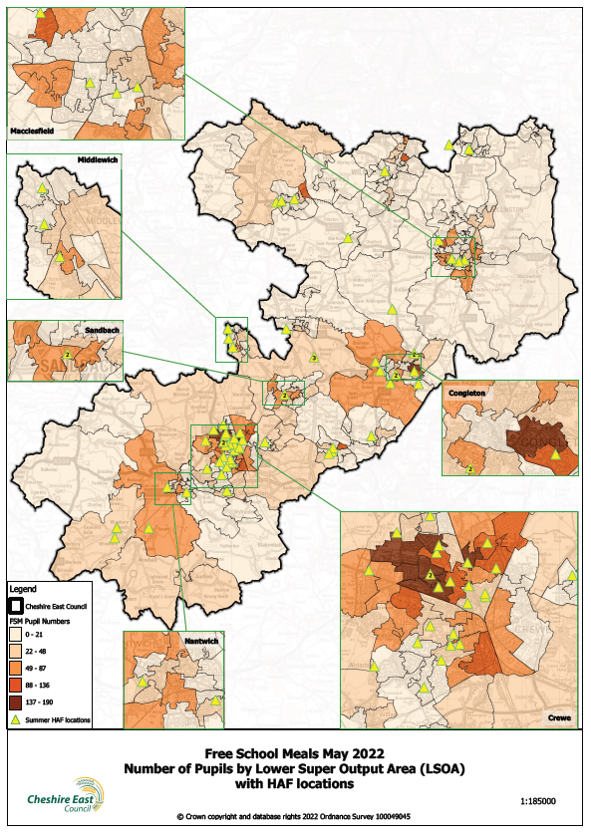

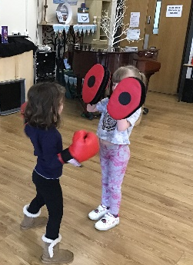
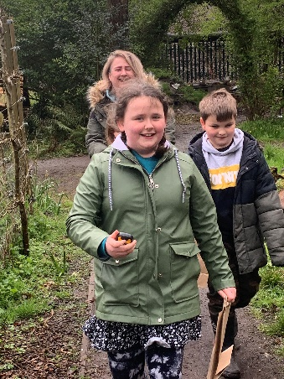
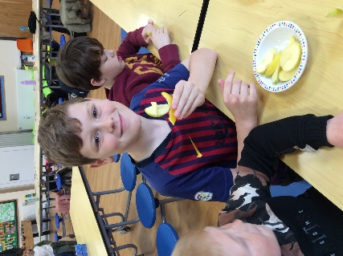
In application…the CE Afghan Programme
The Cheshire East context
What did we do?
Stakeholders and ambassadors
Buy in
Council process
Notes:
Market Engagement event is so close to the Summer Holidays, it would sadly not give us enough time to take their provider feedback and suggestions in to account, when writing the spec & other Procurement documents. December would give us more time to create a more appealing opportunity for them to bid for
Cost effectiveness – PRESSURES FROM DfE TARGET aim is to reach 30% of eligible children and young people. We have approximately 8500K FSM – 2,500 approx. HAF budget is 500K for summer period. £12.50 (Previous average of around £20 - TARGET bids would be sitting between 10-15 per session)

Slide 4
THANK YOU
Questions for group
  Who are your marginalised groups?
  Is there anything you think you could apply to your own area?
  What elements of HAF inclusivity are you struggling with?
douglas.hubbert@cheshireeast.gov.uk
CEHAF@cheshireest.gov.uk

